Slide 1


3 December, 2022
Sponsored and Supported by:

Slide 2

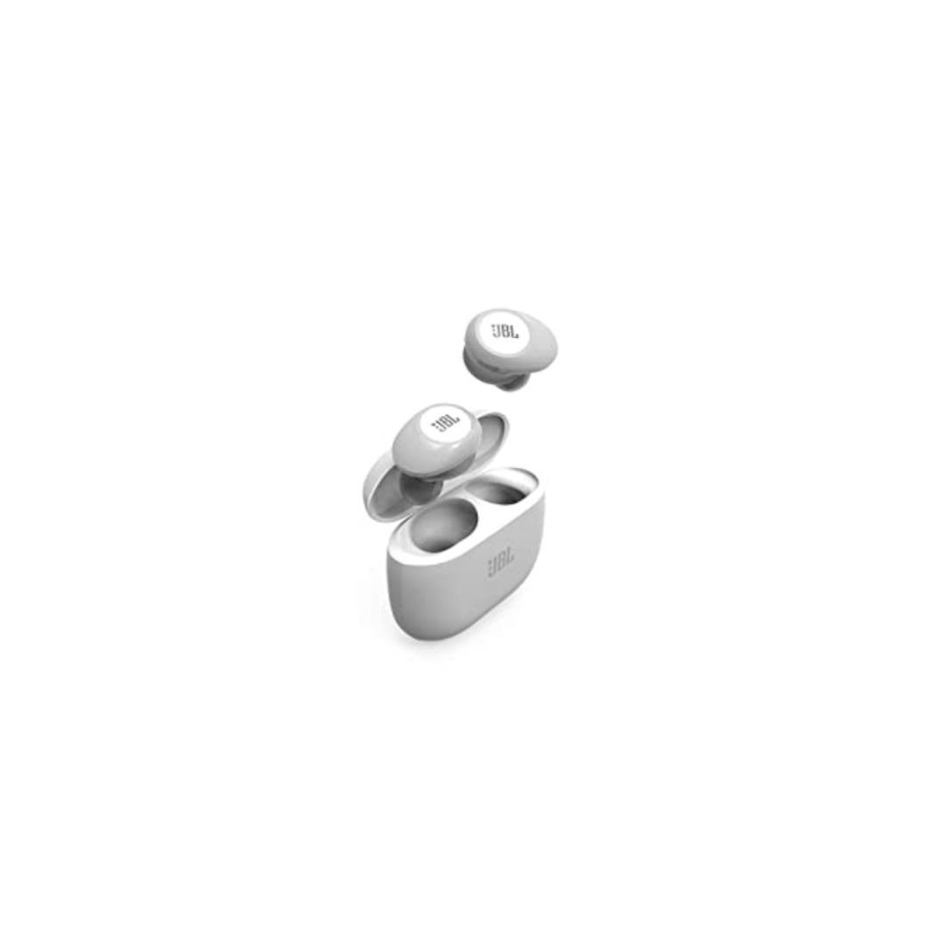
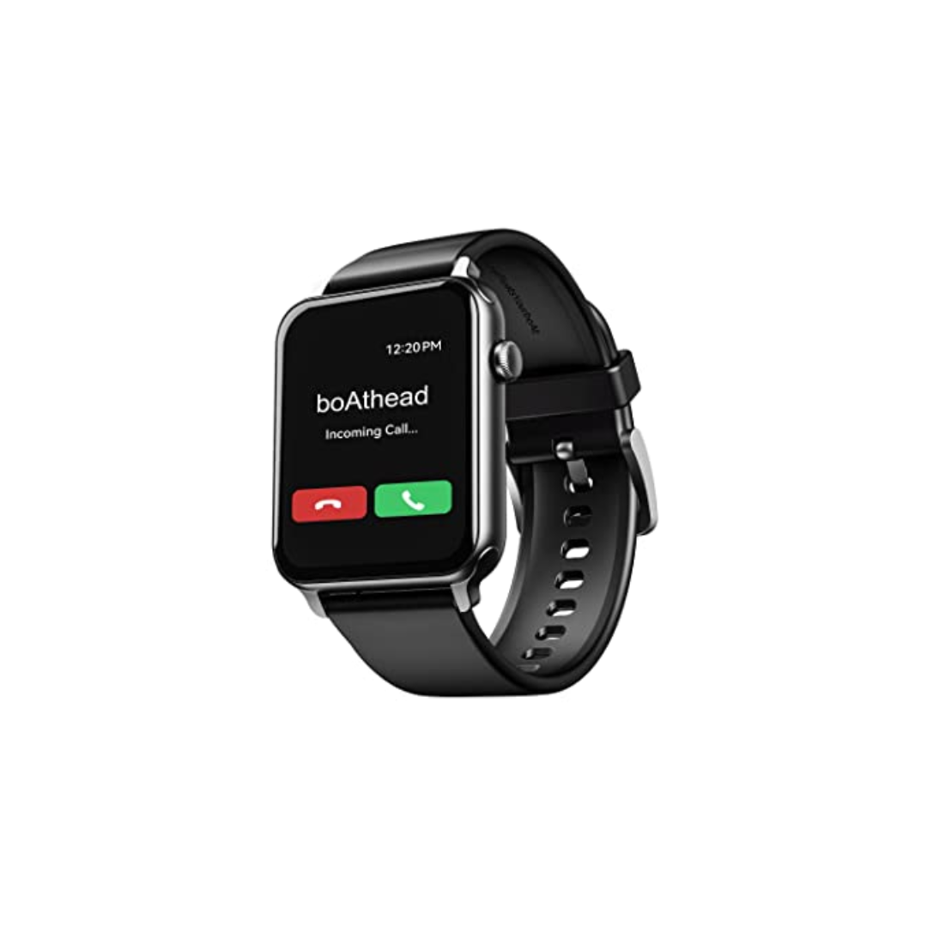
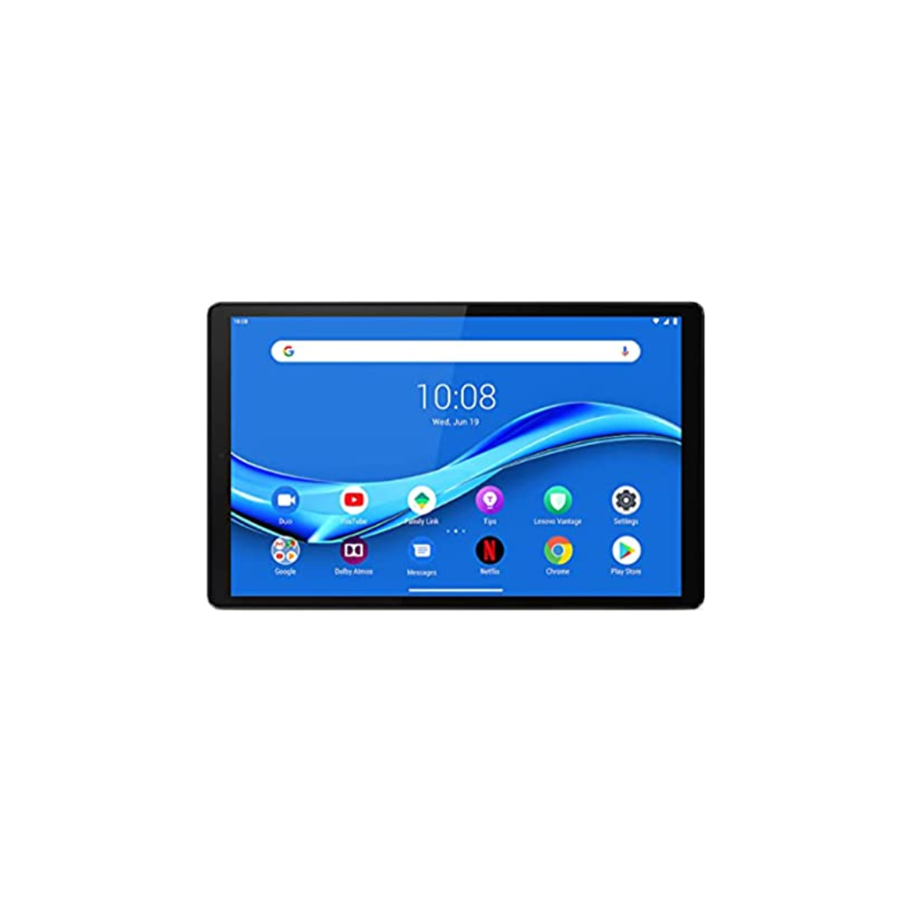
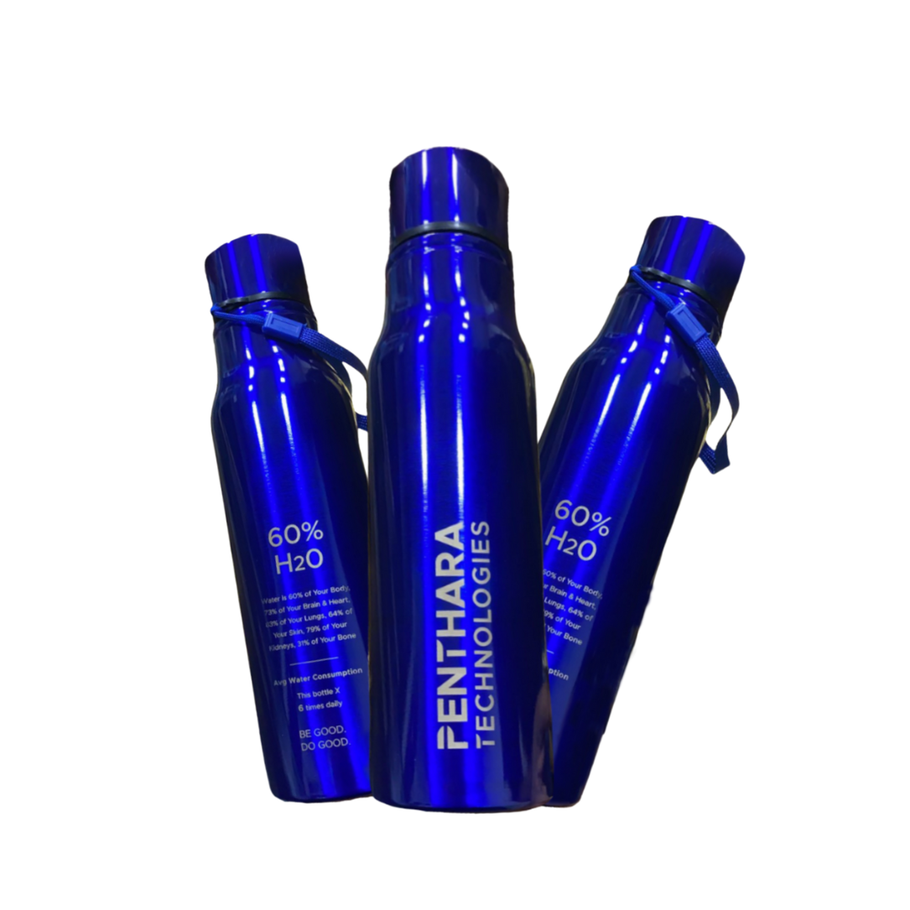

A One Day In Person Event
Win exiting prizes!
Lenovo M10 FHD Plus (2nd Gen)
JBL Tune 125TWS
boAt Blaze Smart Watch
Hands on sessions by experts and community leaders
Deep-dive into Microsoft 365 Services
Focus on:
Microsoft Teams
Power Platform
SharePoint
Cool Water Bottle
Developer Road Ahead

Slide 3

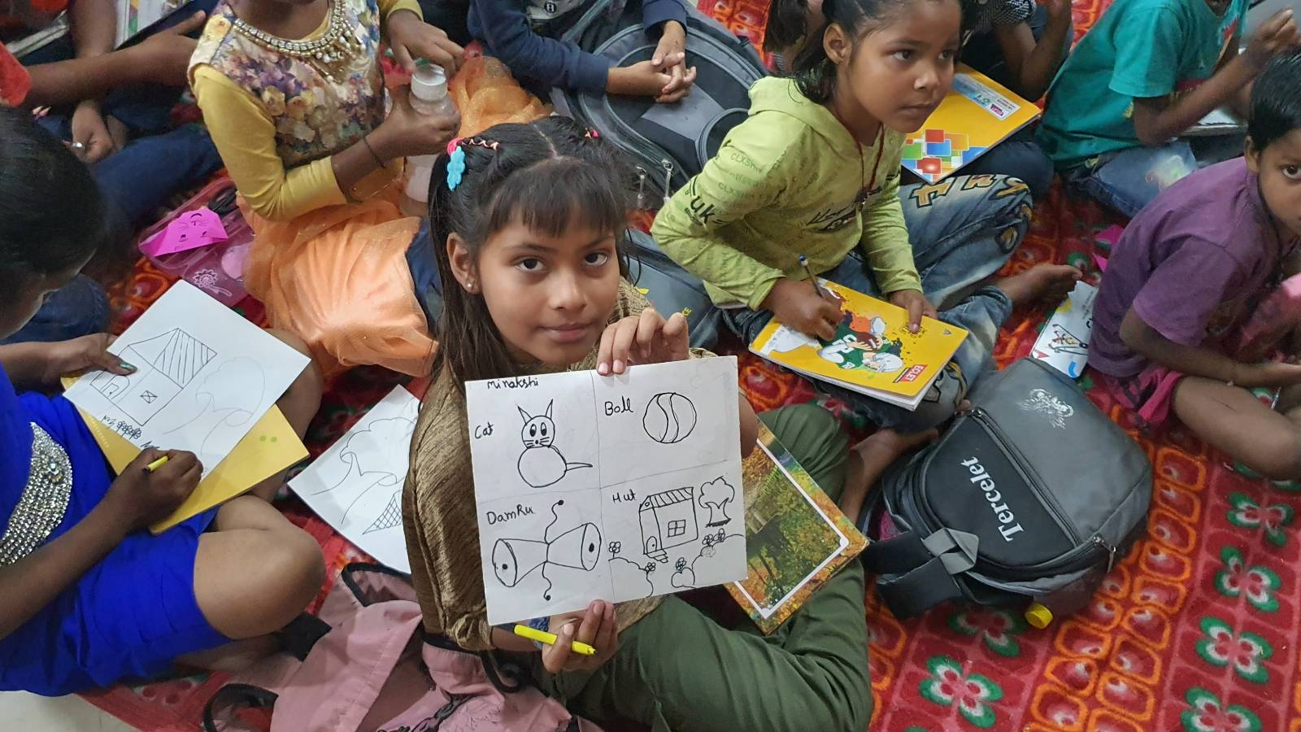
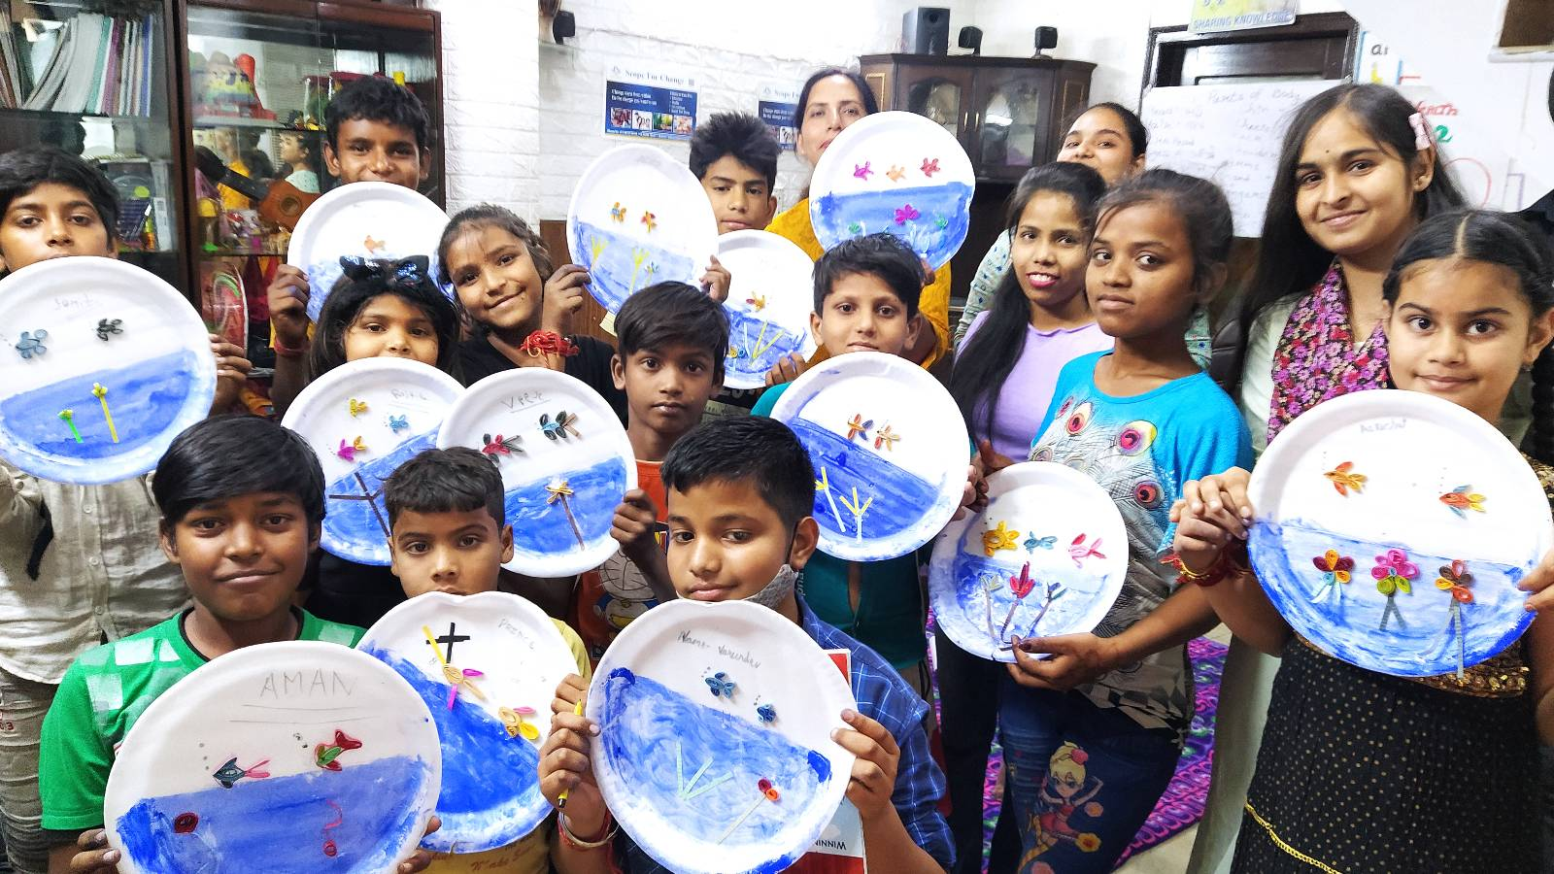

SUPPORT A CAUSE
“Giving is Receiving”
Support ‘Scope for Change’ to create more impact and touch the lives of more underprivileged students.

Slide 4

SPEAKERS PANEL
Session 4
SPFx - Domain Isolated WebParts
11:00 AM – 11:45 AM IST
Sathish Nadarajan
Solution Architect
AstraZeneca

Slide 5
Agenda
What Domain Isolated Apps
How it Works
Pros and Cons
Scenarios where we can use
Demo

Slide 6
What is Domain Isolated Webparts
Web Parts that securely communicate with APIs secured with Azure AD without exposing the access token to other components on the page or even scripts in the tenant.

Slide 7
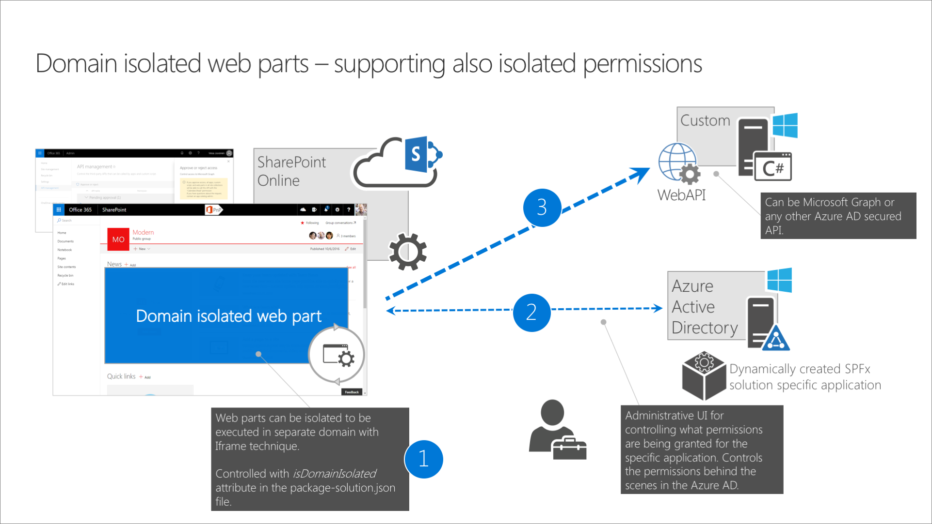

Slide 9
Pros
More Secure
Can be beneficial for the enterprises who is having more than one vendor
Cons
Renders within Iframe
Even the Property Pane renders with Iframe
Not sure, what difference this makes when comparing to Provider Hosted Application

Slide 10
Key Elements
Disposal of Isolated WebPart.
Deploying Isolated Webpart
SPFx Solution should contain only the Webparts. No other components.
Redeploy the solution and the new API permission must be approved by the tenant admin.
Removing Solutions
The API Permissions needs to be removed manually.

Slide 11


Slide 12


Slide 13
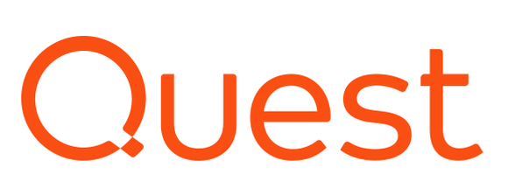
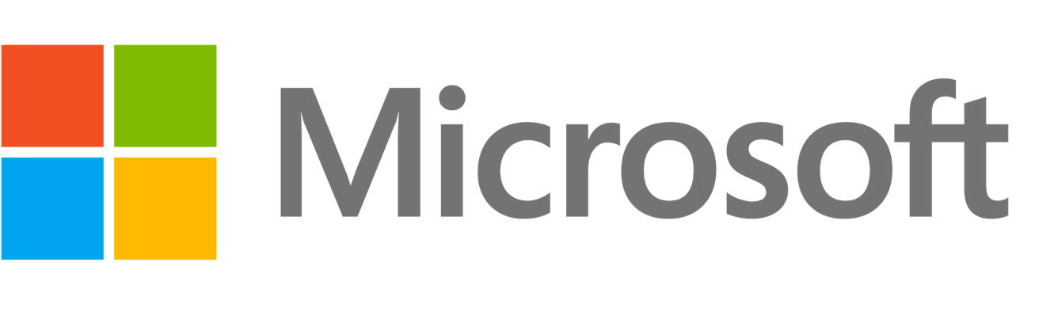
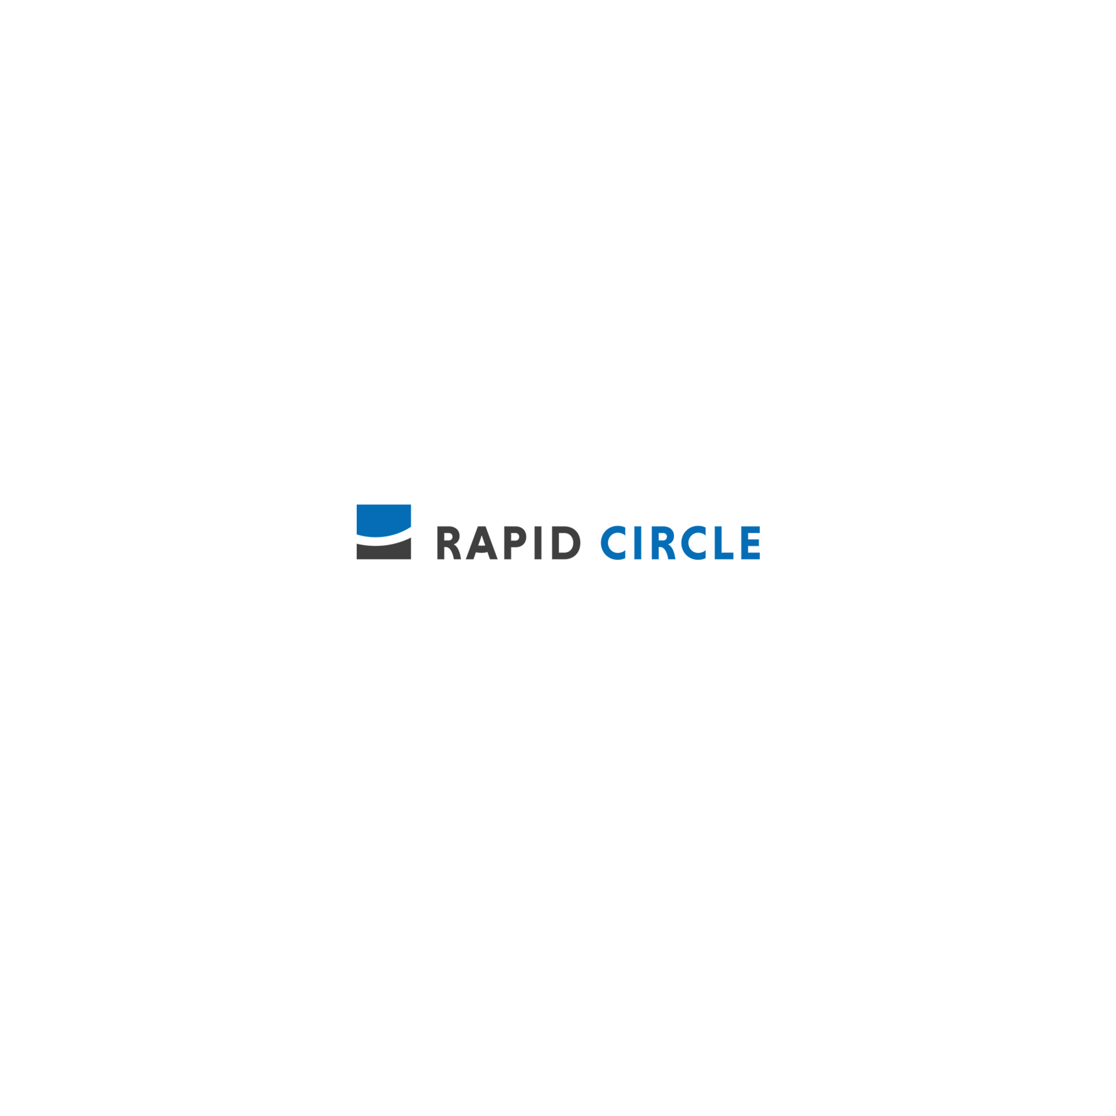
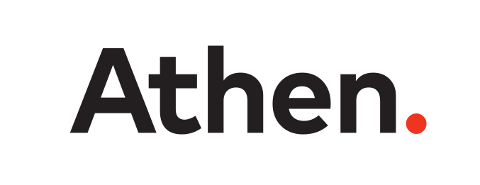


A Big Thank You to all the Sponsors!
Diamond:
Learning Partner:
Platinum:
Gold:

Slide 14


SPEAKERS PANEL
Next Session
Data extraction using M365
11:50 AM to 12:35 PM IST
Divya Akula
Technical Architect
Tarento Technologies

